Slide 1
Visual Analytics: What is InfoVis?
Professor Ian Nabney
ian.nabney@bristol.ac.uk

Slide 2
Overview
Reading: Chapter 1 of Munzner (e-book that can be downloaded from UoB library website)
Understand what information visualisation can do and why we should do it
Frame this by considering 13 key questions
A little history of displaying quantitative information

Slide 3
What is Visualisation?
Computer-based visualization systems provide visual representations of datasets designed to help people carry out tasks more effectively.
Goal of visualisation is to present data in a human-readable way so that people can take action.
Structure around 13 key questions

Slide 4
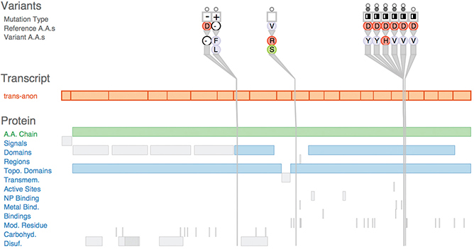
Why have a human in the loop?
Vis allows people to analyse data when they don’t know exactly what questions they need to know in advance
Many analysis problems are ill specified – and actually question refinement takes place as part of the feedback
Transitional use
Understand requirements for computational solution
Refine computational solution
Check automated system
Long-term use – often exploratory analysis (e.g. for scientific discovery)

Slide 5
Why have a computer in the loop?
Scale and accuracy – drawing large datasets by hand is infeasible
Dynamic data changes – redrawing by hand has to start from scratch
Results can be passed to other computational tools

Slide 6
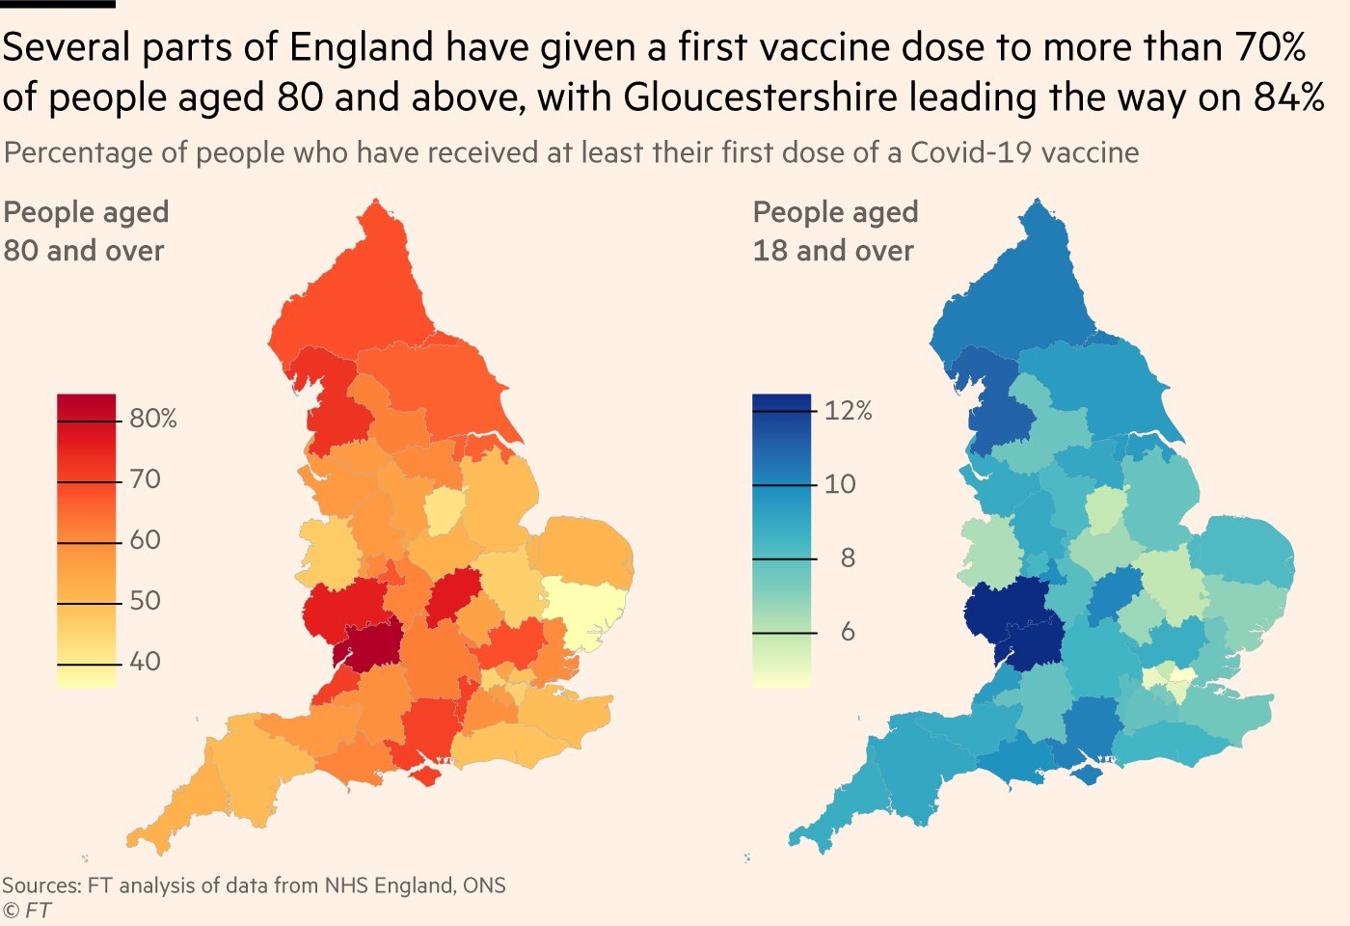
Why use an external representation?
User can offload internal cognition and memory to the perceptual system
Diagrams can be designed to support perceptual inferences
Search can be sped up by grouping all the items needed for a specific problem inference together
An external representation can be shared with others
21/01/2021

Slide 7
Why depend on vision?
Almost half the brain is devoted to the visual sense
Active vision means that we should think about graphic designs as cognitive tools, enhancing and extending our brains
A significant amount of visual information processing occurs in parallel at the preconscious level – we are leveraging this
We only have the illusion of seeing the world in detail: in fact, the brain grabs just those fragments that are needed to execute the current mental activity – we will return to this
Sound is poorly suited because it is a sequential stream
Taste and smell don’t yet have viable recording and reproduction technology
Haptic devices only provide a very limited dynamic range

Slide 8
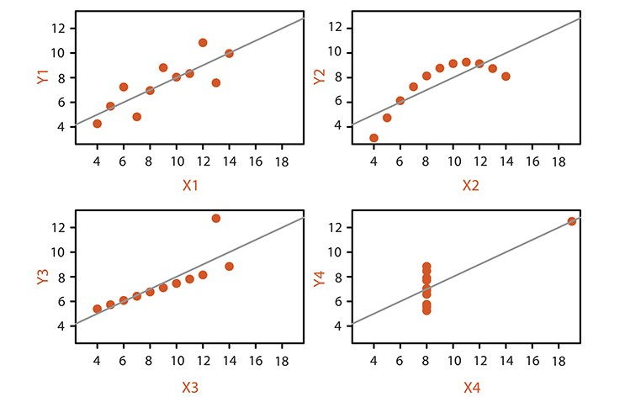
Why show the data in detail?
Anscombe’s quartet of small datasets
All have same mean, variance and correlation
Summary statistics can be very misleading!

Slide 9
Why use interactivity?
Interactivity is crucial to handle complexity
It enables the user to take an active part in exploring data and to ask many different queries
Multiple levels of a hierarchy
Connections between different views of a dataset
Big change from Tufte (static graphics on the page)

Slide 10
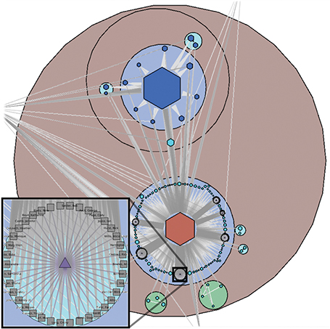
Why is the Vis idiom design space huge?
There are a lot of researchers working in the field!
The design space is bigger now with interaction
Why we need a framework to help choose the right idiom
Grouse vis tool for incremental layout of a multilevel network

Slide 11
Why focus on tasks? Why focus on effectiveness?
Because the point is to help the user solve a problem or understand a challenge, not to draw a picture
The choice of the tool and representation depends on what the user is trying to achieve
Effectiveness as a measure is a corollary of considering tasks
Depicting data is an abstraction – we need ‘graphical integrity’: avoid distorting what the data has to say

Slide 12
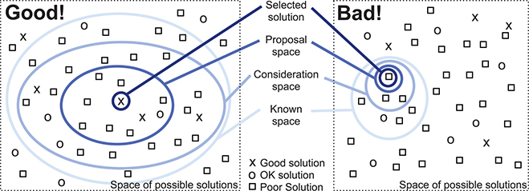
Why are most designs ineffective?
Graphic design is hard, the design space is huge, and we need to match the design to the task
Should consider multiple alternatives (so need to be aware of a range of methods) and then choose the best
Also need a good technique to evaluate designs

Slide 13
Why is validation difficult?
Visualisation is an unsupervised problem with no well-defined quality metrics
What does ‘better’ mean?
Do users get something done faster?
Can they work more effectively (and how do you measure effectiveness?)?
How do you measure ‘data insight’?
Who is the user (expert or novice)?
How do you decide the benchmark data?

Slide 14
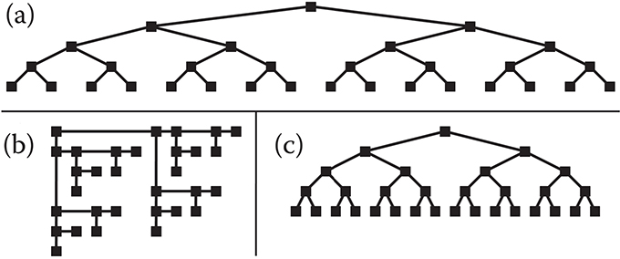
Why are resources limited?
Consider computational capacity, human perceptual and cognitive capacity, and display capacity
Task influences capacity demands:
Interactive response requires algorithms to draw a frame in a fraction of a second
Dataset size can be larger than core memory
Human memory for what is not visible is limited: long-term and short-term
Designers may run out of pixels: information density matters

Slide 15
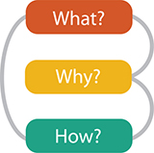
Why analyse vis systems?
The unexamined life is not worth living
Analysis supports improved design (up to a point)
The analysis framework helps you think about design choices systematically
What data the user sees
Why the user uses a vis tool
How the visual encoding and interaction idioms are constructed

Slide 16
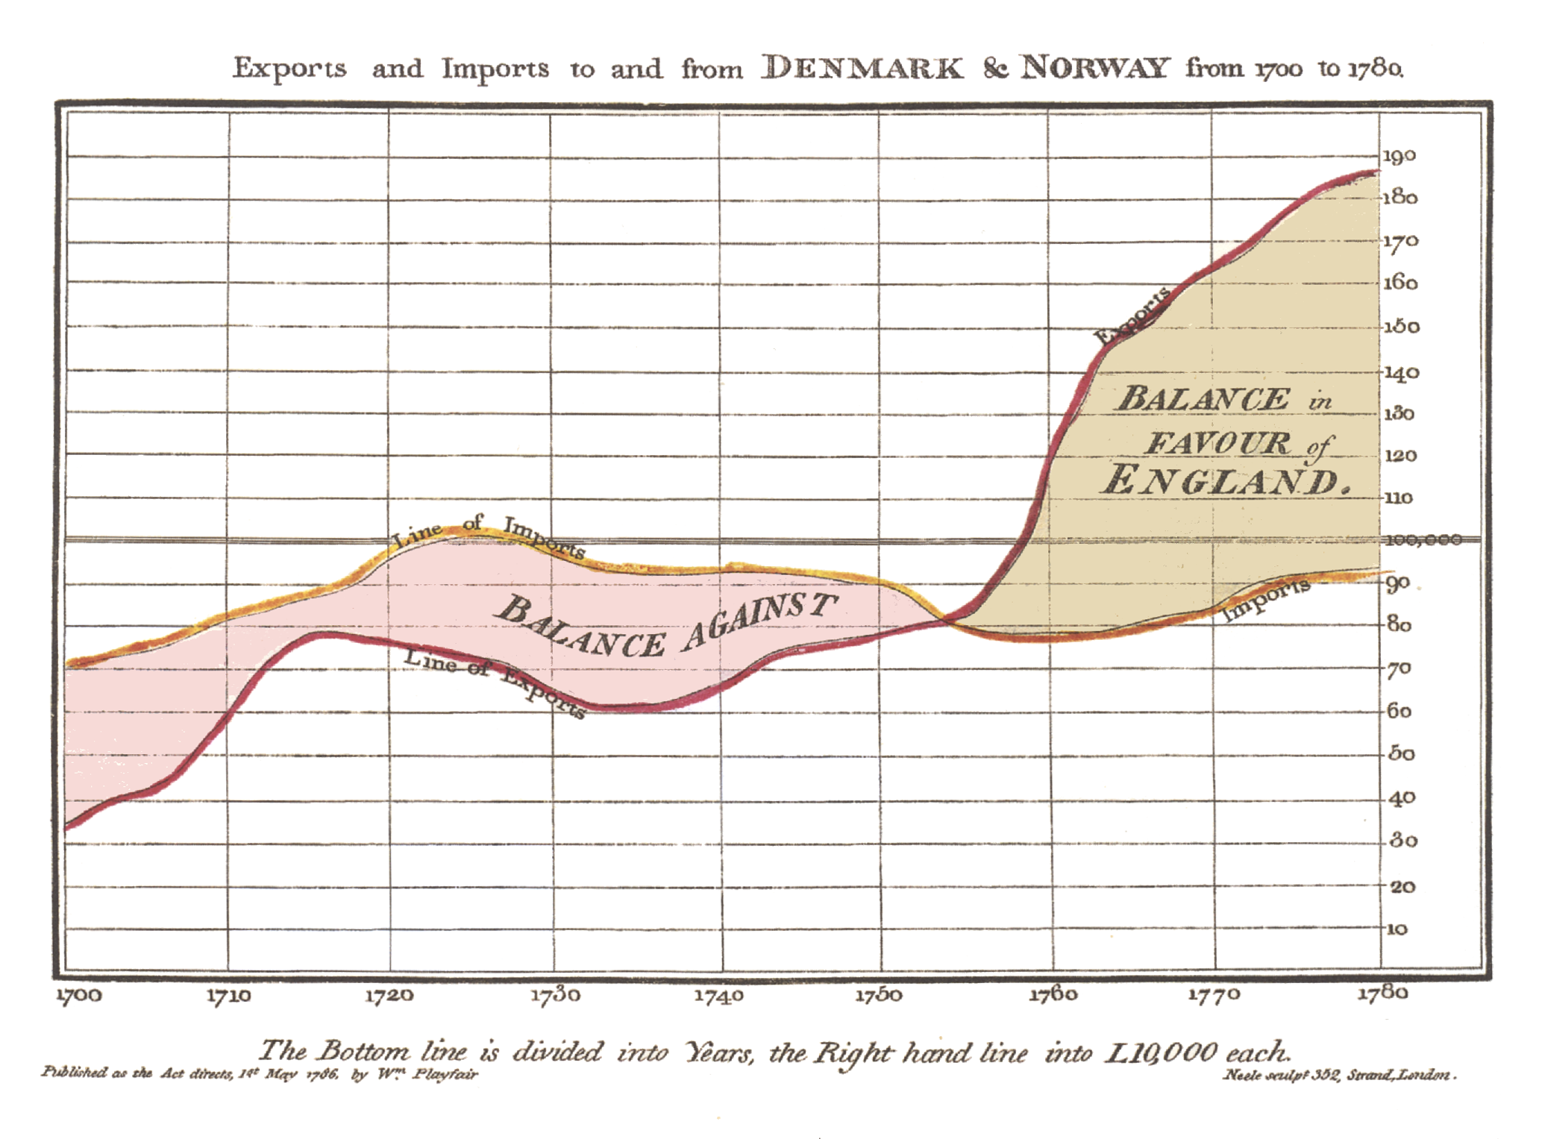
A little history
The invention of data graphics required replacing map coordinates with more abstract measures
This was a surprisingly big step – taken by Johann Heinrich Lambert (1765) and William Playfair (1785) – who invented the line graph
This is despite Descartes (Cartesian coordinates) – 1596-1650
https://seeingcomplexity.wordpress.com/2011/02/03/a-short-visual-history-of-charts-and-graphs/

